Slide 1
Remote Method Invocation

Slide 2
Remote Method Invocation (RMI)
Remote Method Invocation (RMI) is a distributed systems technology that allows one Java Virtual Machine (JVM) to invoke object methods that will be run on another JVM located elsewhere on a network.
This technology is extremely important for the development of large-scale systems, as it makes it possible to distribute resources and processing load across more than one machine.

Slide 3
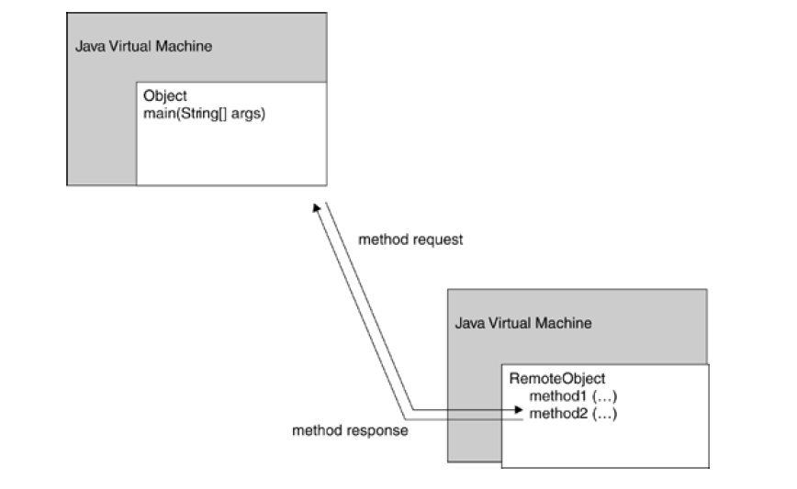
Basic concept behind RMI

Slide 4
an object running on one JVM invokes a method of an object hosted by another JVM.
Communication like this does not have to be a one-way process, either—a remote object method can return data as well as accept it as a parameter.

Slide 5
RMI services
Each RMI service is defined by an interface, which describes object methods that can be executed remotely.
This interface must be shared by all developers who will write software for that service—It (interfaces) acts as a blueprint for applications that will use and provide implementations of the service.
More than one implementation of the interface can be created, and developers do not need to be aware of which implementation is being used or where it is located.

Slide 6
How does RMI work
Systems that use RMI for communication typically are divided into two categories: clients and servers.
A server provides an RMI service, and a client invokes object methods of this service.
RMI servers must register with a lookup service, to allow clients to find them, or they can make available a reference to the service in some other fashion.
Included as part of the Java platform is an application called rmi-registry, which runs as a separate process and allows applications to register RMI services or obtain a reference to a named service.
Once a server has registered, it will then wait for incoming RMI requests from clients.

Slide 7
How does RMI work
Associated with each service registration is a name (represented as a string), to allow clients to select the appropriate service.
If a service moves from one server to another, the client need only look up the registry again to find the new location. This makes for a more fault tolerant system
If the service is unavailable because a machine is down, a system administrator could launch a new instance of the service on another system and have it register with the RMI registry.
Providing the registry remains active, you can have your servers go online and offline or move from host to host.
The registry doesn't care which host a service is offered from, and clients get the service location directly from the registry.

Slide 8
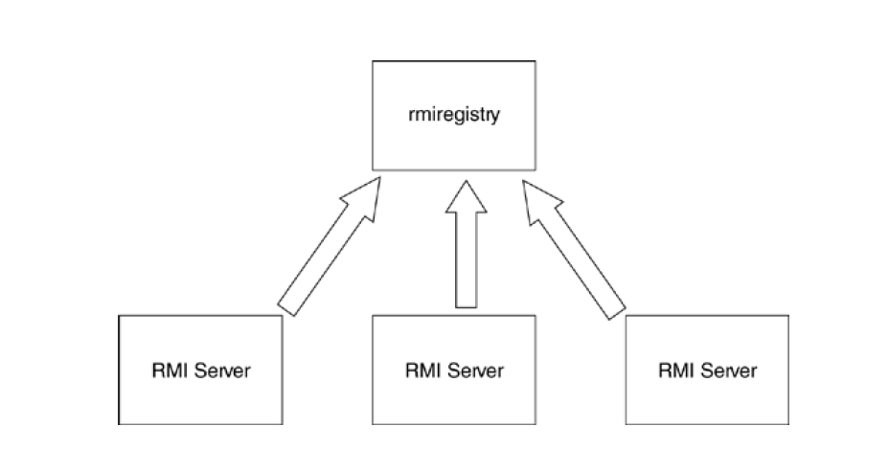
Multiple services can register with the same registry.

Slide 9
How RMI works
RMI clients will send RMI messages(Empty Interface) to invoke an object method remotely.
Before any remote method invocation can occur, however, the client must have a remote object reference. This is normally obtained by looking up a service in the RMI registry.
The client application requests a particular service name, and receives a URL to the remote resource. The following format is used by RMI for representing a remote object reference:
rmi://hostname:port/servicename
where hostname represents the name of a server
(or IP address), port the location of the service on that
machine, and service name a string description of the service.

Slide 10
Stubs and skeleton
Once an object reference is obtained (either through the rmi-registry, a custom lookup service, or by reading an object reference URL from a file), the client can then interact with the remote service.
The networking details of requests are completely transparent to the application developer—working with remote objects becomes as simple as working with local ones.
This is achieved through a clever division of the RMI system into two components, the stub and the skeleton.

Slide 11
Stubs
Remember that every RMI service is defined as an interface, not as an implementation.
The stub object implements a particular RMI interface, which the client application can use just like any other object implementation.
Rather than performing the work itself, however, the stub passes a message to a remote RMI service, waits for a response, and returns this response to the calling method.
The application developer doesn't need to be concerned about where the RMI resource is located, on which platform it is running, or how it will fulfill the request.
The RMI client simply invokes a method of the proxy object, which handles all the implementation details.

Slide 12
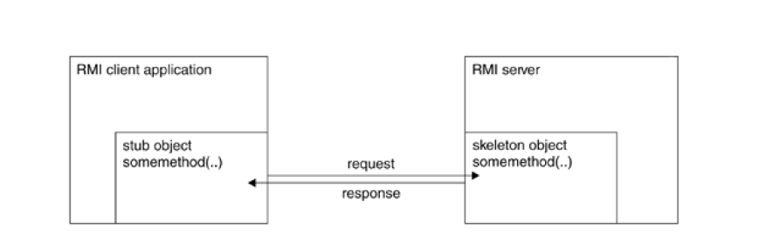
Communication between stub and skeleton

Slide 13
What Skeleton does
At the RMI server end, the skeleton object is responsible for listening for incoming RMI requests and passing these on to the RMI service.
The skeleton object does not provide an implementation of an RMI service, however. It only acts as a receiver for requests, and passes these requests on further.
After a developer creates an RMI interface, he or she must still provide a concrete implementation of the interface. This implementation object will be called by the skeleton object, which invokes the appropriate method and passes the results back to the stub object in the RMI client.
This model makes for much simpler programming, as the skeleton is separated from the actual implementation of the service.
All the developer of the server needs to be concerned about is some brief initialization code (to register a service and accept requests), and providing an implementation of the RMI service interface.

Slide 14
Stubs and skeletons
RMI uses stub and skeleton objects to provide the connection
between the client and the remote object.
A stub is a proxy for a remote object which is responsible for forwarding method invocations from the client to the server where the actual remote object implementation resides.
A client's reference to a remote object, therefore, is actually a reference to a local stub. The client has a local copy of the stub object.
A skeleton is a server-side object which contains a method that dispatches (sent out) calls to the actual remote object implementation.
A remote object has an associated local skeleton object to dispatch(sent out) remote calls to it.

Slide 15
RMI Stubs And Skeletons
Note: Java 2 (JDK1.2) does not require an explicit
skeleton class.
The skeleton object is automatically provided on the
server side.
A method can get a reference to a remote object by
looking up the remote object in some directory
service.
RMI provides a simple directory service called the
RMI registry for this purpose by receiving the
remote object reference as a method argument or
return value.

Slide 16
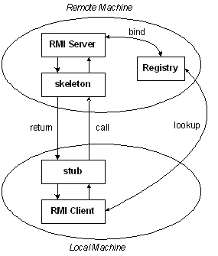

Slide 17
RMI Steps
Step1:
Create and compile an interface that specifies
the methods that will have remote access.
• Must be public
• Must extend the interface java.rmi.Remote
• Each remote method must have a throws
java.rmi.RemoteException clause
• Interface must reside on both the server and the
client side
• Any method parameters or return value of a
reference type must implement Serializable.

Slide 18
RMI steps
Step 2:
Write and compile a class that implements the
remote interface in 1.
• Must extend
java.rmi.server.UnicastRemoteObject
• Must implement the remote interface in 1
• Its constructors must be defined explicitly since
they each may throw java.rmi.RemoteException
• Resides on the server side only

Slide 19
RMI steps
Step 3:
Create the stub class using the rmic tool.
rmic ImplementationClass
• Leave the stub on the server side
• Put a copy of the stub class on the client side

Slide 20
RMI Steps
Step 4:
Write and compile a server class that Instantiates an object
of the implementation class in 2;
This is the remote object
• Binds the remote object implObj to a unique identifier
(a String) for the rmi registry
java.rmi.Naming.rebind("uniqueID", implObj);
Note: The implementation class and the server class can be combined into one class, particularly if there is no need for the server class to extend another class.

Slide 21
RMI Steps
Step 5:
Write and compile a client class that
• Requests an object from the remote server using its
hostname and the unique identifier of the object, and
then casts that object to the interface type from 1.
InterfaceType it = (InterfaceType)java.rmi.Naming.lookup(
"rmi://localhost/uniqueID");
1099 is the default port and if used, its specification here can be
omitted.
If the client is running on the same machine as the remote object (the server), use localhost.

Slide 22
RMI Steps
Step 6:
Start the bootstrap rmi registry in the
background on the server side.
Start rmiregistry
Step 7:
Execute the server class on the machine that the
client named, java ServerClass
Note: The rmi registry and the server must run on the same machine and in the same directory.

Slide 23
RMI Steps
Step 8:
Execute the client class on another machine
java ClientClass
Note: Any objects that will be passed as parameters to the remote object method or returned as its result must be Serializable.

Slide 24
Example

Slide 25
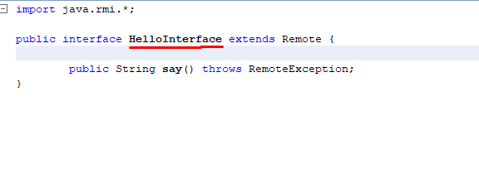
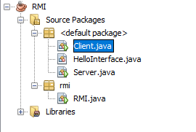
RMI Code

Slide 26

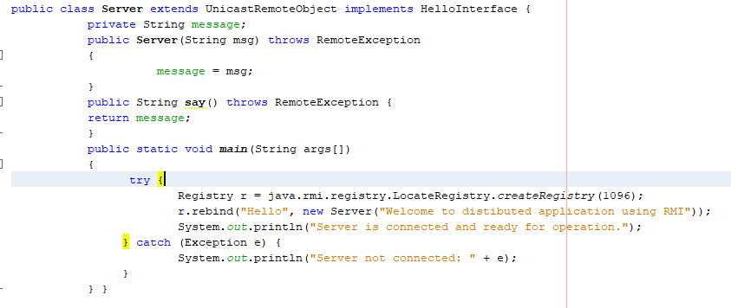
RMI Code (Server Class)

Slide 27
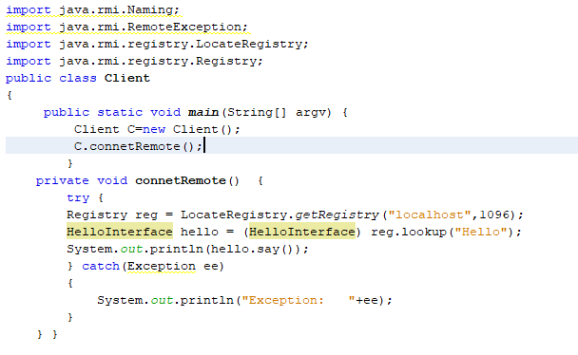
RMI Code (Client Class)

